Slide 1
Real-Time Vision-Based Solar Tracking System
SOLAR PANEL

Slide 2

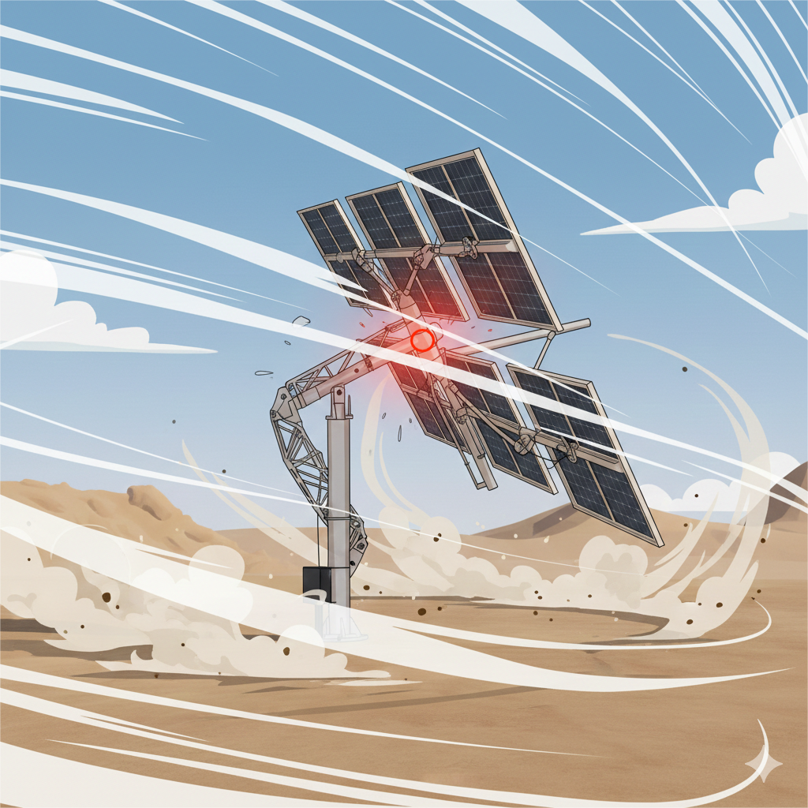
Limitations of Existing Systems
01
Fixed System
Panels stay at fixed angles
Cannot follow the sun throughout the day
Significant energy loss
02
Serial Pan-Tilt Systems
• Use cantilevered moving arms • Low stiffness under wind loads • Vibrations reduce tracking accuracy
SOLAR PANEL
03
Passive Tracking
• Light sensors are sensitive to noise (Poor accuracy) • Struggle in cloudy or bright conditions
Problem：Open-loop systems accumulate errors, causing large tracking misalignment.

Slide 3
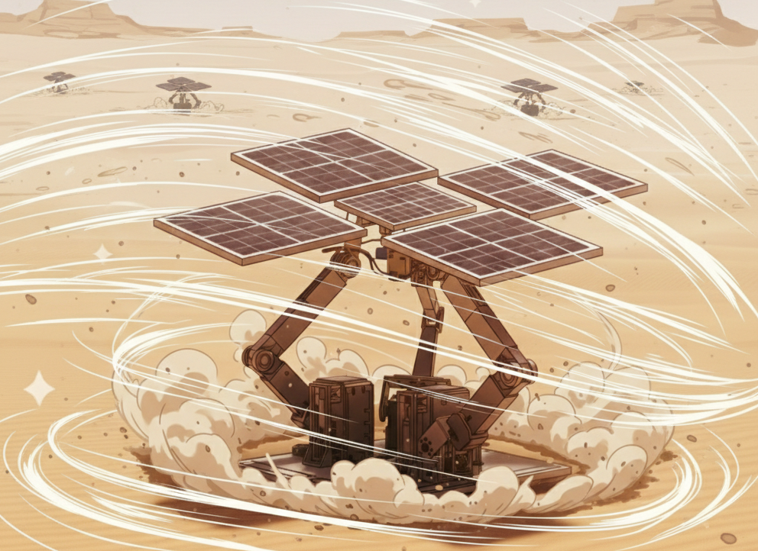
Our Solution
3RRS Parallel Mechanism：
High Dynamic Stiffness
Distributes load across three chains
Eliminates cantilever effects.
Real-Time Vision Control:
Camera-based sun tracking feedback
Nonlinear inverse kinematics solved in real time
Eliminates tracking errors with closed-loop control

Slide 4
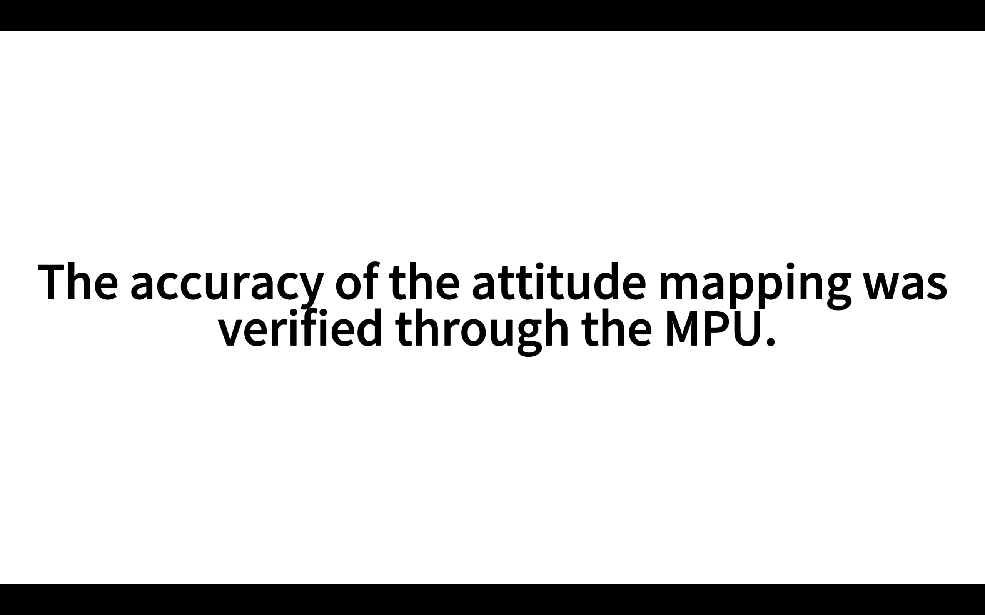
Feasibility Testing

